Slide 1

Accenture - Ralph Lauren
GenAI in Receivables Management
Purdue University

Slide 2
Table of contents
01.
02.
03.
AR Ledger
Disputes
Accounts Receivable Agent & Accounts Receivable
Dispute Resolution Agent & Contract Accounting
Risk & Revenue
Behavioral Insights & Agent for Incorrect Credits
Purdue University

Slide 3
01.
AR Ledger
Saandiya, Tolu, Parth
Purdue University

Slide 4
Current State and Agent Overview
SAP Cash Application (AR Agent)
Human-Driven Process
Fit in L5 Workflow
Primary Task:
Automatically match incoming payments to open invoices
Read bank statements + remittance data
Uses reinforced learning from accountants' actions
75% reduction in effort analyzing and reconciling open AR items
L5 Step: Apply incoming payments to open receivables
Payments received (ACH / Wire / Cash / Check)
AR accountants manually need to:
Investigate remittance data
Match payments to invoices
Clear invoices or flag issues
Lot of high-volume repetitive work
Major processing bottleneck
Exact Placement:
After payment is received
Before invoice clearing / dispute handling
Main changes in L5:
AI replaces manual matching as default path
Human involvement becomes conditional

Slide 5
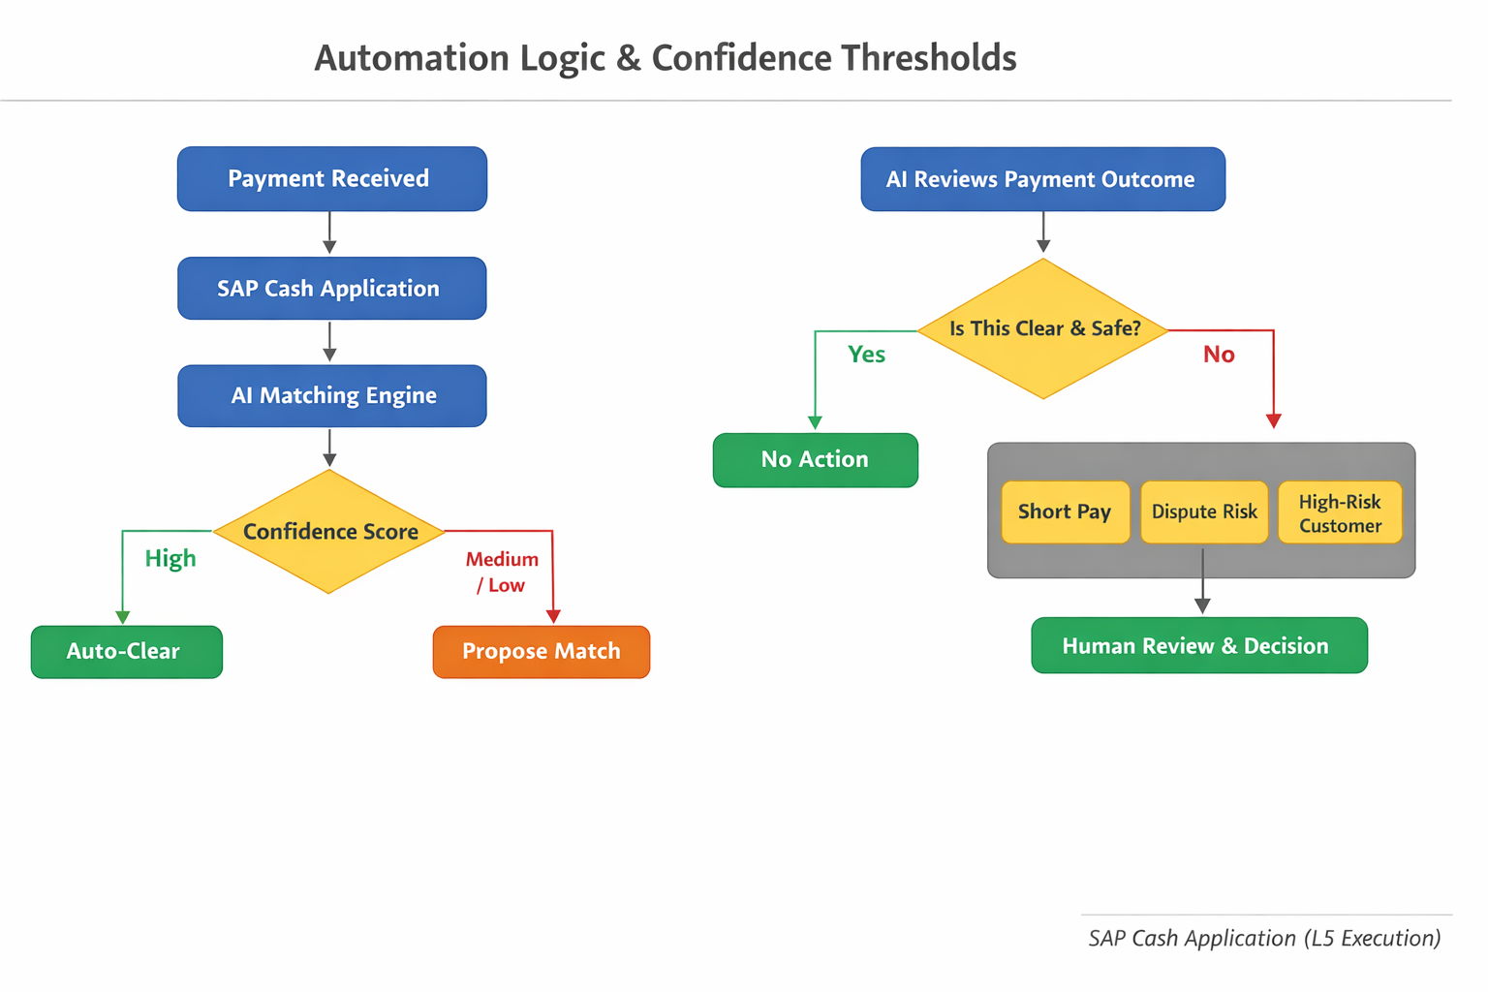
Automation Logic & Decision Thresholds (AR app)
AI-Driven Process
Autonomous Matching: AI scans bank statements and remittance data to propose invoice matches
Confidence Scoring:
High confidence → Auto-clearing
Medium confidence → AI recommendation
Predictive Risk Awareness: AI highlights which payments or exceptions need urgent attention

Slide 6
Accounts Receivable Agent
Decision Control
AI handles the matching
Humans review only flagged exceptions
AR Accountant shifts from “doer” → “reviewer”
When Is It Automated?
Repetitive, high-volume payments
Clear remittance data
Standard customers and invoices
High-confidence matches
When Does It Escalate?
Low Confidence: Short payments or missing invoice references
Edge Cases: New customer behavior or complex disputes
Risk-Based Escalation: High-risk or high-value invoices flagged by Joule

Slide 7
02.
Disputes
Mayank, Byron, Rhea
Purdue University

Slide 8
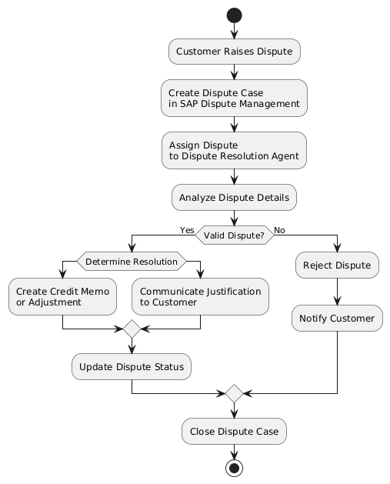
Dispute Resolution Agent
Before (Manual Process):
Accountants review invoices and contracts
Decide if disputes are valid
Apply corrections
Slow and error-prone
Dispute Case Management:
Automatically reviews invoices and contracts
→ replaces manual review
Checks if customer complaints are justified
→ supports faster decisions
Suggests or triggers corrections (e.g., credit memos) → reduces delays and back-and-forth
Why the agent isn’t useful (dispute case opening)l:
The dispute hasn’t been investigated yet → no invoice/contract analysis needed
No corrections or payments are involved → nothing for the AI to act on
Work is mostly intake and routing, which is simple administrative work

Slide 9
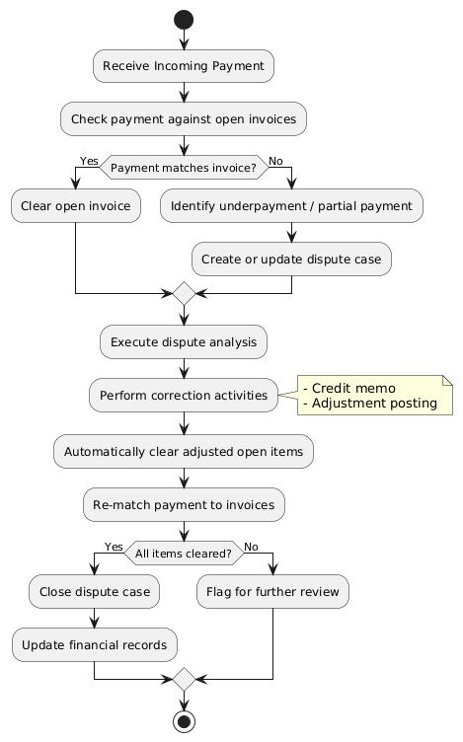
Contract Accounting
Before (Manual Process):
Manually match payments to invoices
Clear accounts after corrections Slow, error-prone, delays dispute closure
After (With AI Agent):
Automatically matches payments to open invoices
Clears accounts and re-matches after corrections
Detects underpayments/partial payments
Speeds up dispute closure and reduces errors
Dispute Case Management:
Automatically matches payments to open invoices
→ reduces manual work
Detects underpayments or partial payments
→ speeds up dispute resolution
Clears accounts after corrections
→ ensures accurate financials
Dispute Case Opening:
AI not useful → dispute hasn’t been investigated yet, so nothing to analyze or correct
Stage is mostly intake: detecting disputes, creating cases, assigning to the right team

Slide 10
03.
Risk & Revenue
Allison, Prabhu, Tanvi
Purdue University

Slide 11
Behavioral Insights Agent
What does it do?
Where does the Agent Fits in L5:
Helps collection specialists predict payment risk by analyzing historical customer behavior, maximizing collections and minimizing write-offs
1. Execute Bad Debt Reserves & Allowances
Primary Tasks
Evaluates historical invoice and payment data to score contract accounts by payment risk
Flag accounts likely to pay late or default
Assigns risk scores to highlight priority cases and explains the behavioral patterns driving those risks
Enhances financial stability such that collections teams can prioritize follow-ups and act early while improving the cash flow
Acts as the primary intelligence layer between "Run Valuation" and "Approve Valuation Proposal," replacing static aging rules with real-time risk predictions.
2. Review Dispute Mgt. Performance & KPIs
Before (Manual Process):
No automated explanation of payment behavior
Payments are processed according to rules with no behavioral context from prior customer payment history.
Late payment signals are detected only after failure
No process to identify risky customers
After (With AI Agent):
Payment risk is predicted before execution
Uses behaviour data to focus payment processing on the highest-priority accounts
Flags problematic accounts early to fix defaults and disputes
Takes smarter control of cash flows
Acts as the Real-Time Analytics & Root-Cause Layer that sits between "Data Consolidation" and "Management Review." replacing manual data digging by providing constant updates on why disputes are happening and predicting which ones will occur next so management can fix the root cause immediately.

Slide 12
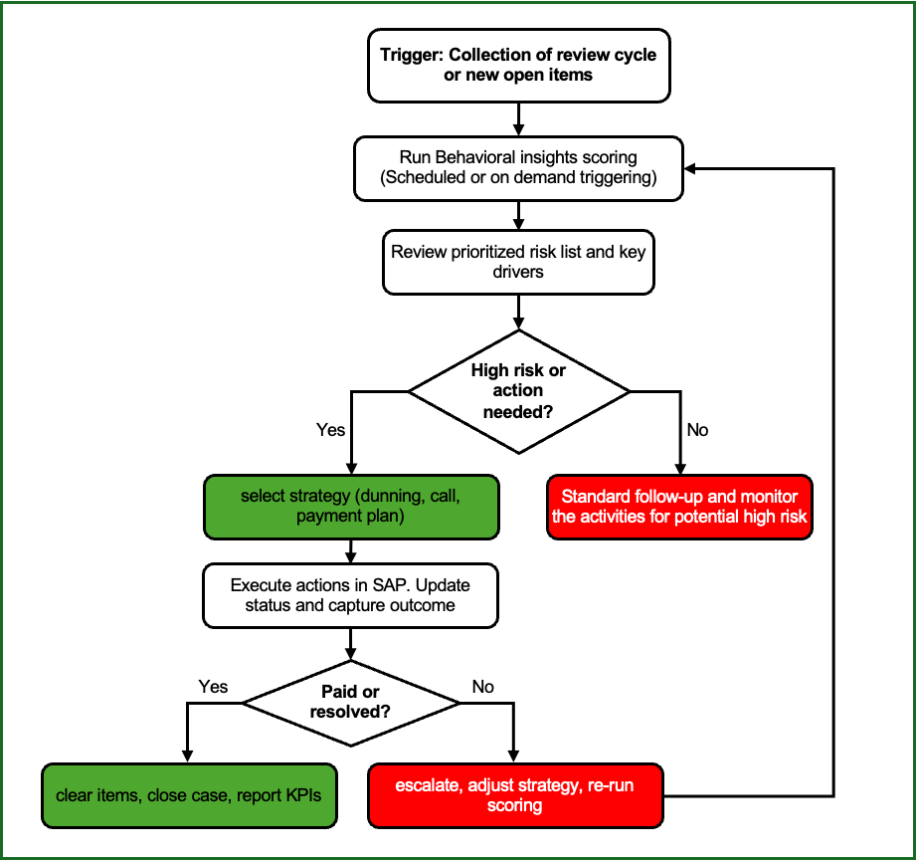
Why this agent is useful?
Identifies the real "problem" accounts.
Fixes issues before they happen.
Smarter financial planning
Resolves arguments faster
Process Overview:
Behavioral Insights is triggered by a review cycle or new open items, running a scoring process to produce a prioritized risk list with key drivers
The collector reviews the list, acts on high-risk items (choosing and executing a strategy in SAP), and records outcomes. Resolved or paid items are cleared and KPIs are reported
Unresolved cases are escalated or the strategy is adjusted, and scoring is rerun in a loop for subsequent review cycles.

Slide 13
Incorrect Credits Agent

Slide 14
Thank You

